Slide 1
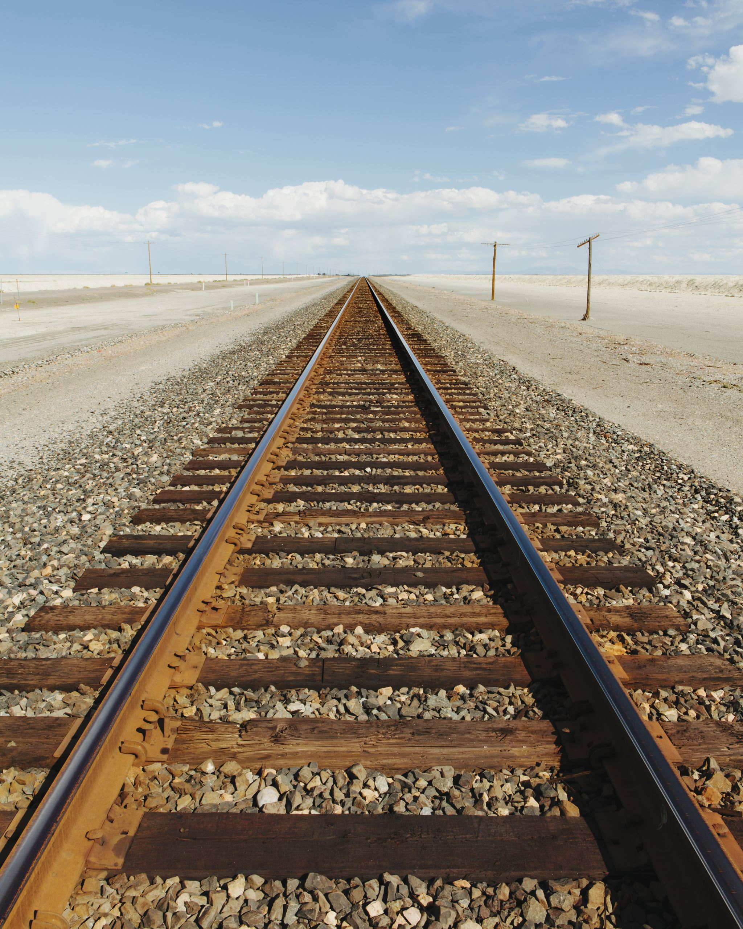
optimization of transporting crops to a city.
Prepared by:
Mahmoud Zain Sabto 180501448
Oubai Nasrallah 170501632.
Salem Zeidan 190501142.
Razan Abusabrah 190501492.
Khalid Saud 180501244.

Slide 2
abstract:
This project provides valuable insights into the solution of a real-life problem on finding the best configuration of transportation of crops to a city.
in order to achieve the lowest cost possible.
Since transporting goods is one of the major costs of any company, minimizing its cost is a necessity.

Slide 3
introduction
As the world began to grow, farms and factories had to be relocated to areas outside of cities.
we now must think about the cost of transporting goods, which was easy and close before the Industrial Revolution.
With the growth of cities came to the development of transportation methods such as trains, aircraft, trucks, and ships capable of transporting tons of goods.

Slide 4

distribution of the corps
Istanbul is a big city, and it requires a lot of crops, the crops are distributed from farms to 7 major warehouses in the city.
there are 4 major farms that supply these warehouses with fruits and vegetables, the demand and production capability and the cost of transporting the crops is shown in table(1).
we will determine the optimal configuration of transporting 2 categories (fruits and vegetables).
* (demand and production are by KG, cost is by TL per 1GK).

Slide 5
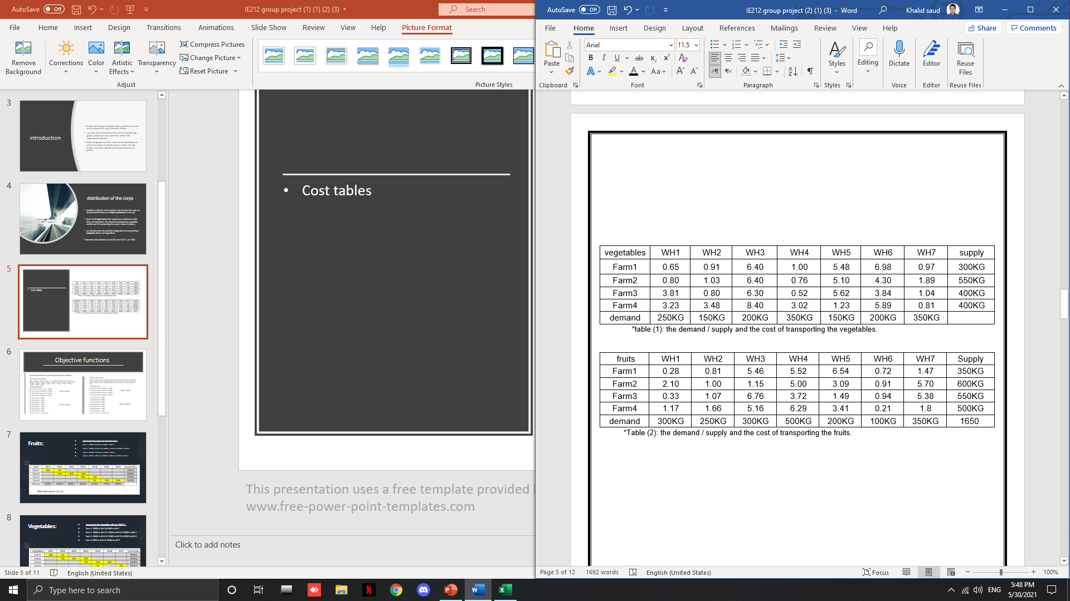
Cost tables

Slide 6
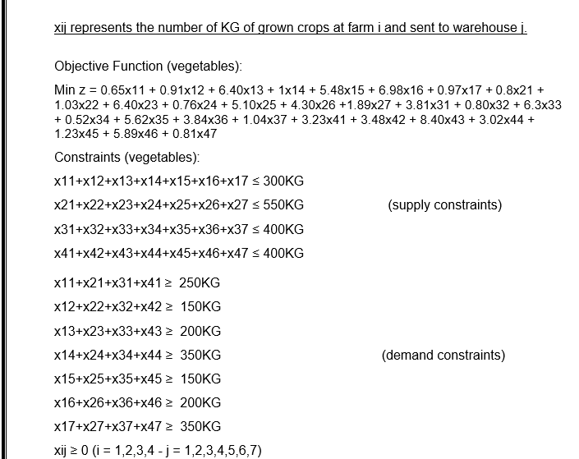
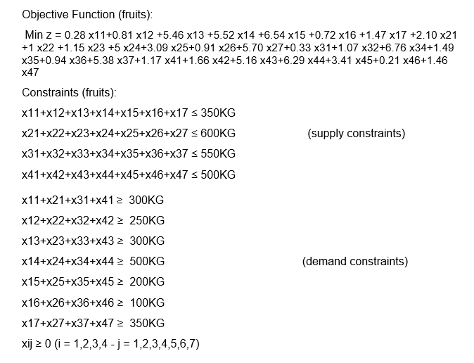
Objective functions

Slide 7
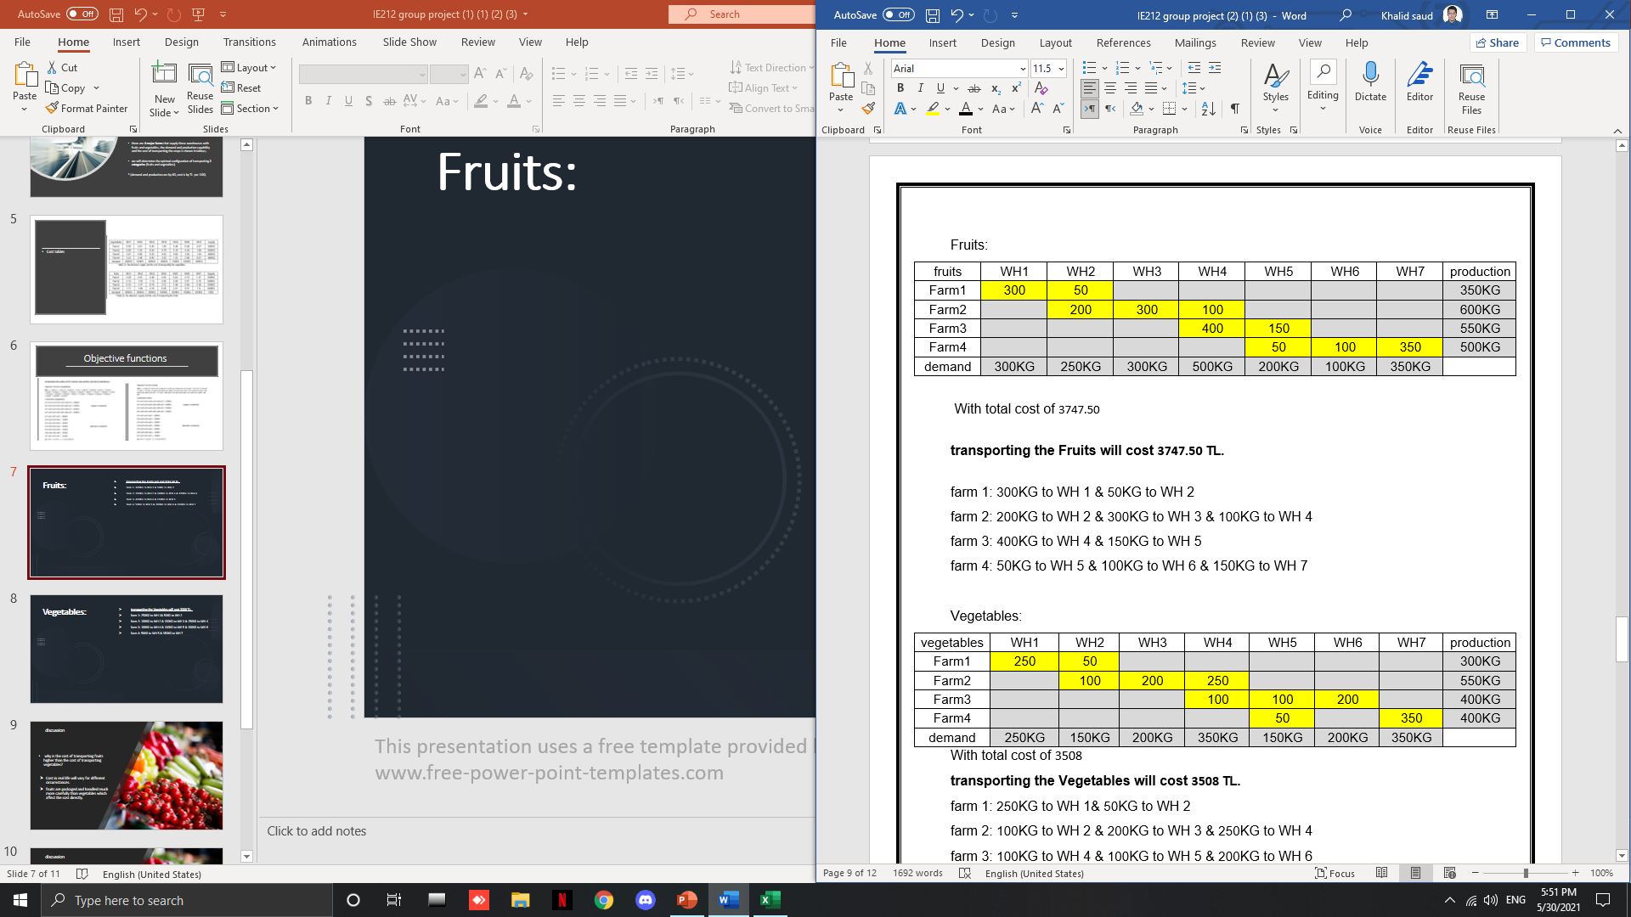
Fruits:
transporting the Fruits will cost 3747.50 TL.
farm 1: 300KG to WH 1 & 50KG to WH 2
farm 2: 200KG to WH 2 & 300KG to WH 3 & 100KG to WH 4
farm 3: 400KG to WH 4 & 150KG to WH 5
farm 4: 50KG to WH 5 & 100KG to WH 6 & 150KG to WH 7

Slide 8
Vegetables:
transporting the Vegetables will cost 3508 TL.
farm 1: 250KG to WH 1& 50KG to WH 2
farm 2: 100KG to WH 2 & 200KG to WH 3 & 250KG to WH 4
farm 3: 100KG to WH 4 & 100KG to WH 5 & 200KG to WH 6
farm 4: 50KG to WH 5 & 350KG to WH 7

Slide 9
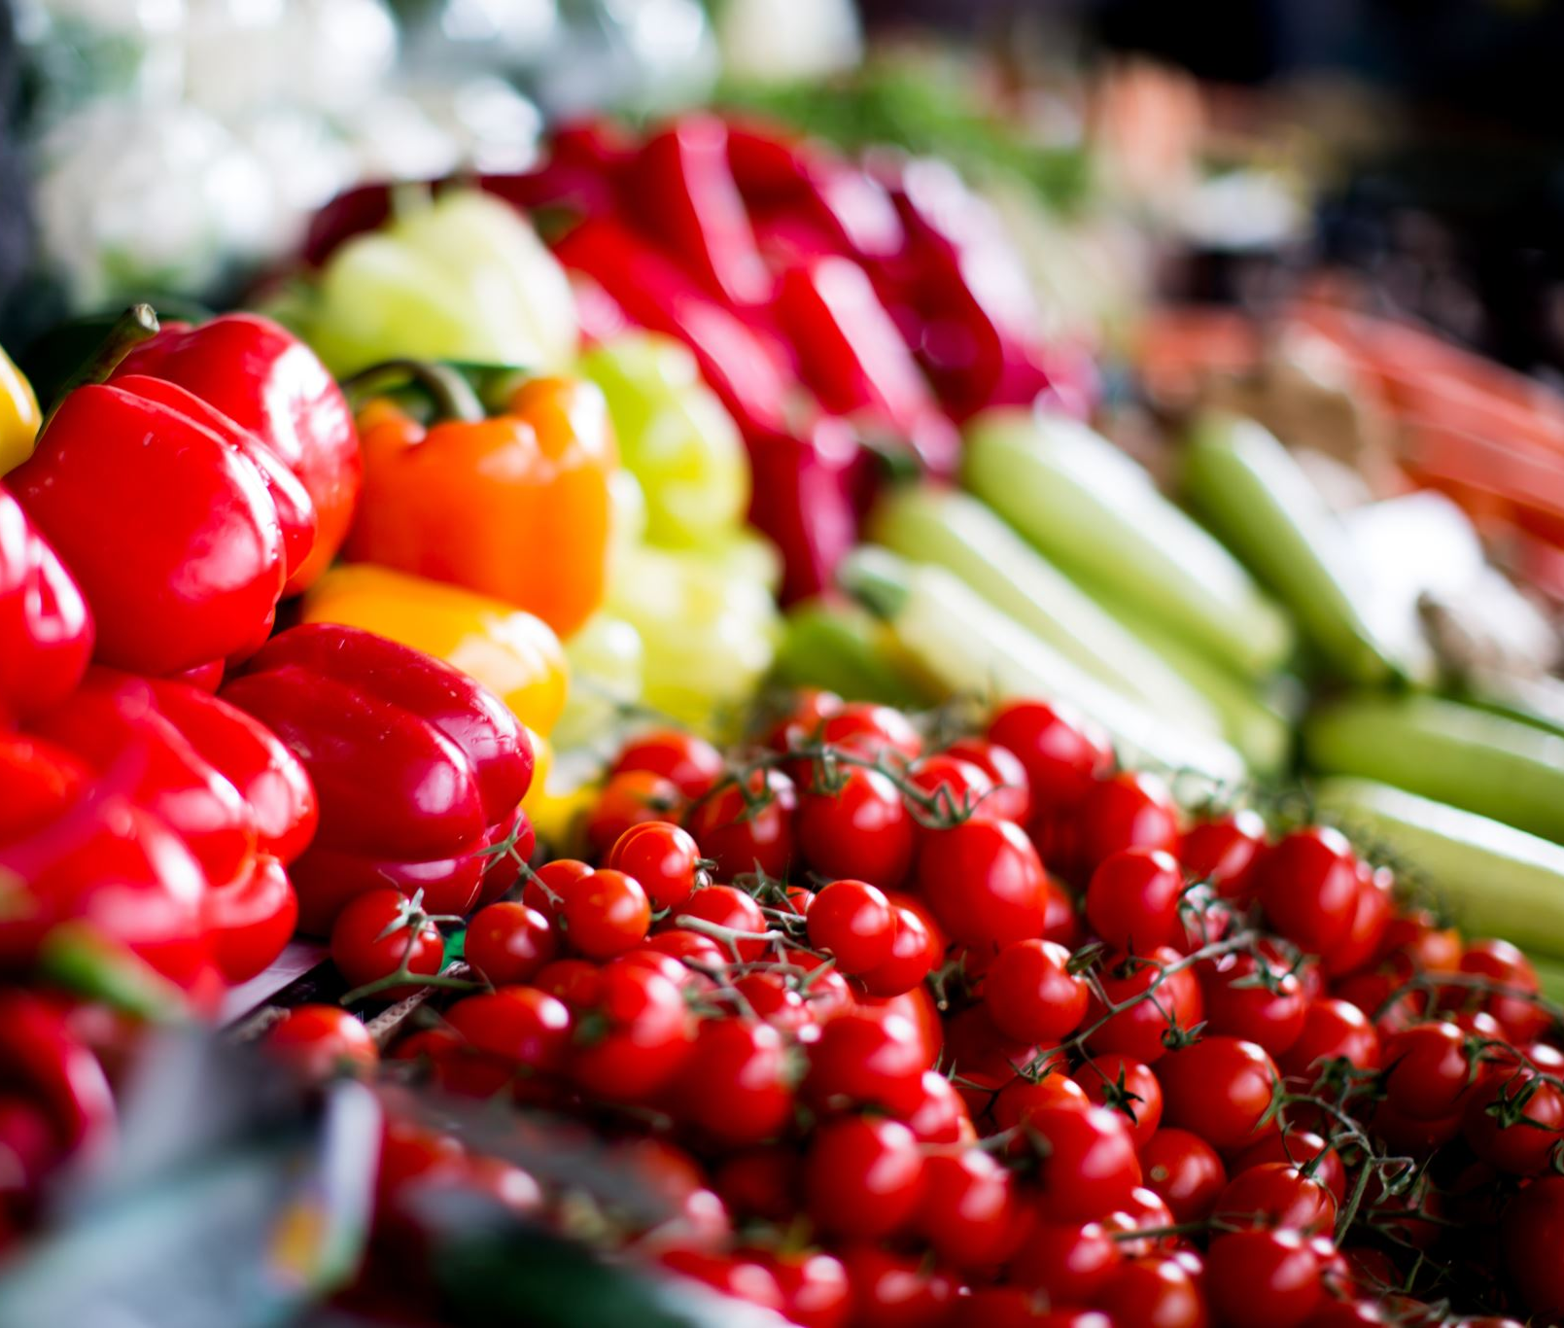
discussion
why is the cost of transporting fruits higher than the cost of transporting vegetables?
Cost in real life will vary for different circumstances.
fruits are packaged and handled much more carefully than vegetables which affect the cost directly.

Slide 10
discussion
should the transpiration company keep shipping these good separately or combining them would be easier?
it could happen but we need to make sure the goods doesn’t collapse on top of the fruits.
we need to package the goods according to what type of fruits or vegetables are.

Slide 11

References
Iannotti, M. (2021, February). How to Grow Prickly Pear Cactus. Marie Iannotti. https://www.thespruce.com/growing-prickly-pear.
Winston, W. L. (1990). Operations Research: Applications and Algorithms. P.W.S.-Kent Publishing Co.,U.S. https://itslearningakarmazyan.files.wordpress.com.
Topcu I. and Kabak O., 2016, Introduction to Operations Research, Lecture Notes.
Paltrinieri, G. (2000). (postharvest) handling of fresh fruits and vegetables. food and agriculture organization of the united nations.

